Slide 1
DATA RIDERS BANKLOAN : Decision tree and random forest
Presented by:
Smitha Jha
Santhosh Kumar
Yuvaraj Nachimuthu
Ekta Chaurasia
Avishek Deb
Srinath Ganesh

Slide 2
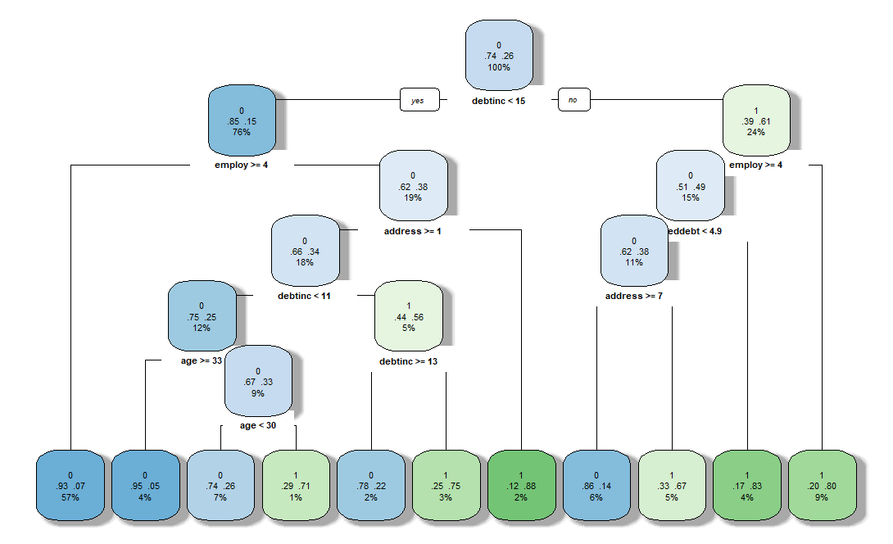
DECISION TREE - MODEL

Slide 3
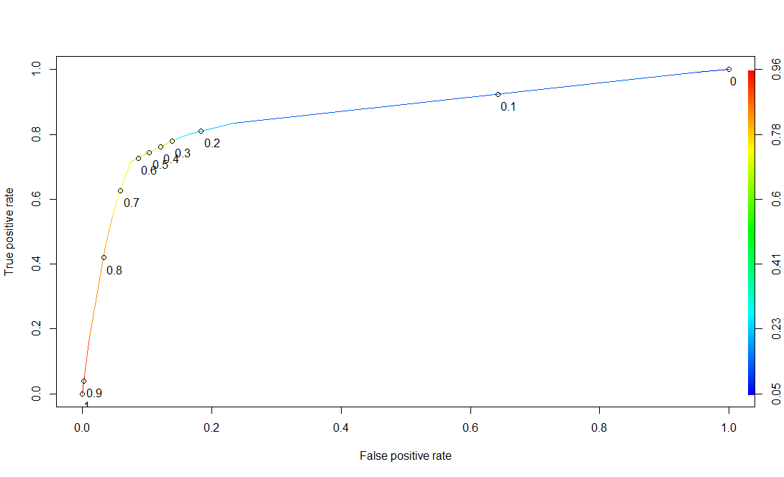
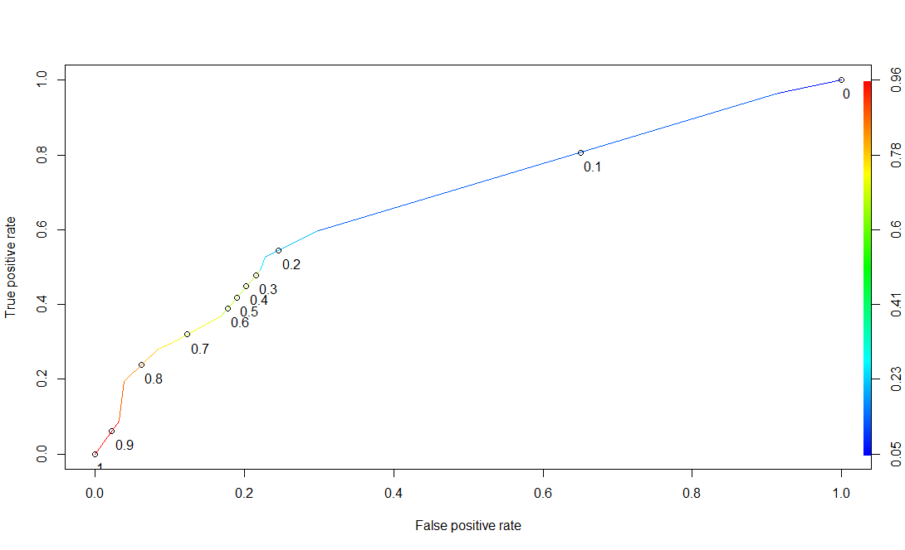
Decision Tree : Train & Test ROC Curve
Train data
Test data

Slide 4
Decision tree - Confusion Matrices
Confusion Matrix (Train data) |  | Predicted
 |  | No | Yes
Actual | No | 278 | 85
 | Yes | 21 | 105
21 are Predicted as ND but will default 85 Predicted as defaulter but ND
Confusion Matrix (Test data) |  | Predicted
 |  | No | Yes
Actual | No | 108 | 46
 | Yes | 23 | 34
23 are Predicted as ND but will default 46 Predicted as defaulter but ND

Slide 5
Decision Tree : Train and test Results
 | Train | Test
Accuracy | 78.32 | 67.3
Precision | 55.26 | 42.5
Specificity | 76.58 | 70.13
Sensitivity (Recall) | 83.33 | 59.65
AUC | 86.02 | 67.07

Slide 6
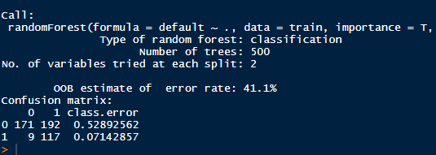
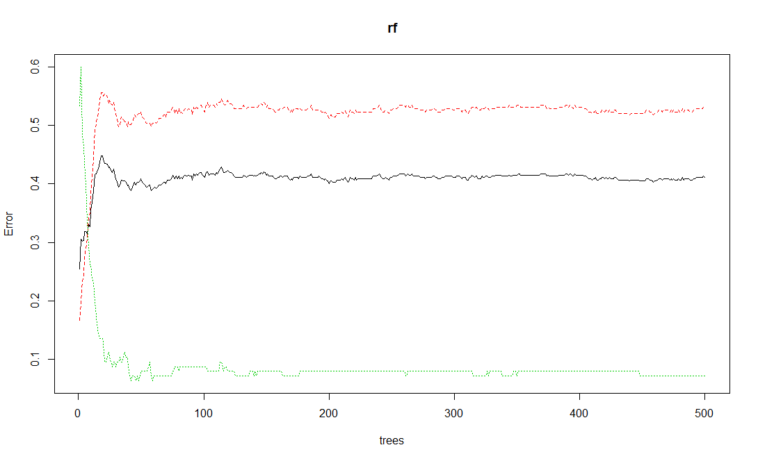
Random Forest: Model

Slide 7
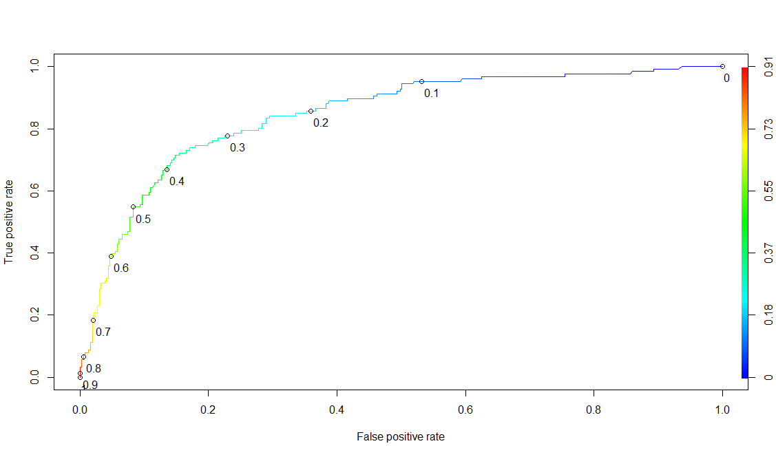
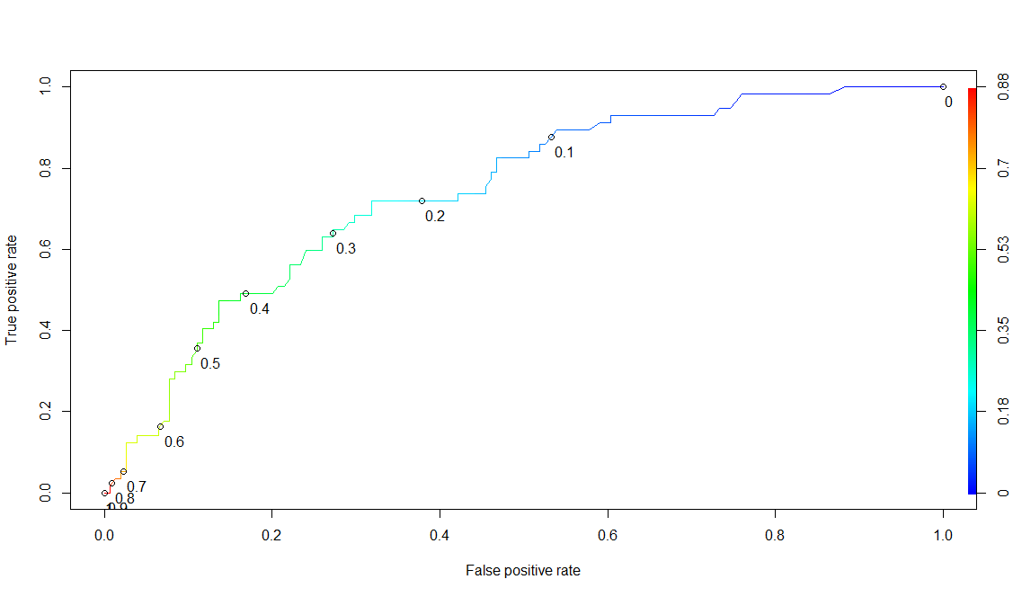
Random Forest: ROC Curve
Train data
Test data

Slide 8
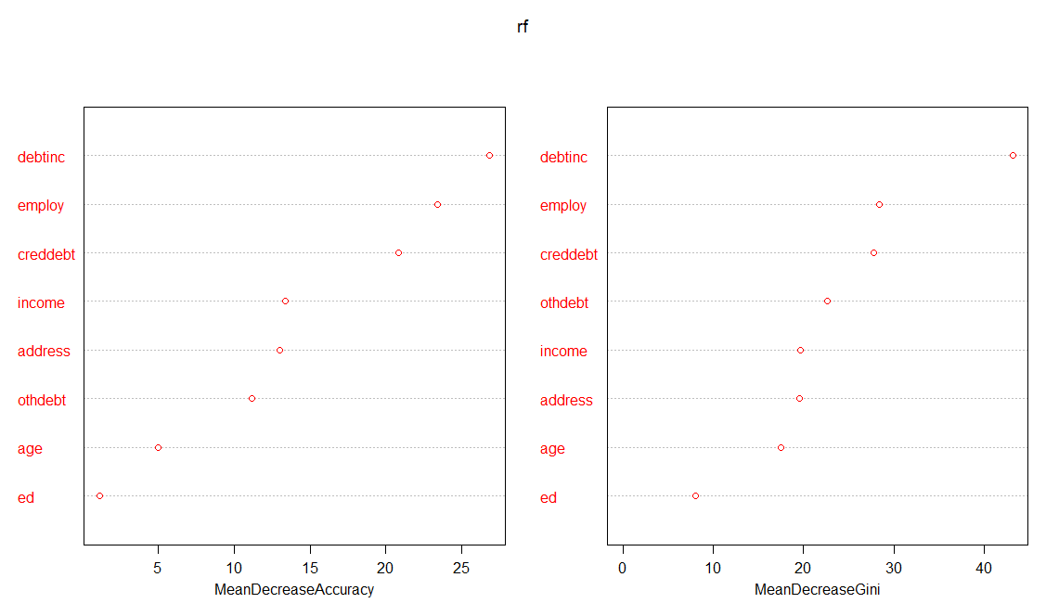
RF: Variables and Conf Matrix
Confusion Matrix (Train) |  | Predicted
 |  | No | Yes
Actual | No | 170 | 193
 | Yes | 6 | 120
6 Predicted as ND but will default 193 Predicted as defaulter but ND
Confusion Matrix (Test) |  | Predicted
 |  | No | Yes
Actual | No | 71 | 83
 | Yes | 9 | 48
9 Predicted as ND but will default 83 Predicted as defaulter but ND

Slide 9
RF : Train and Test Results
 | Train | Test
Accuracy | 59.3 | 56.4
Precision | 38.34 | 36.64
Specificity | 46.83 | 46.10
Sensitivity (Recall) | 95.24 | 84.21
AUC | 84.4 | 74.2

Slide 10
Thank You
Github - https://github.com/srinathganesh1/Data-Riders/tree/master/LogisticRegression
Website - https://datariders.wixsite.com/datarider

